Slide 1
Remote Work Challenges & Solutions
Moderated by:
Josh Witte, RFMP Director Facilities and Store Services Dollar Tree | Family Dollar

Slide 2
Panelists
Lisa Smola-Hollo – Construction Projects and Analysis Manager
Amber Hoyt – Sr Digital Product Mgr, Associate Product Innovation
Soy Thomas – Dir of Construction, A&E, and BLR India Facilities

Slide 3
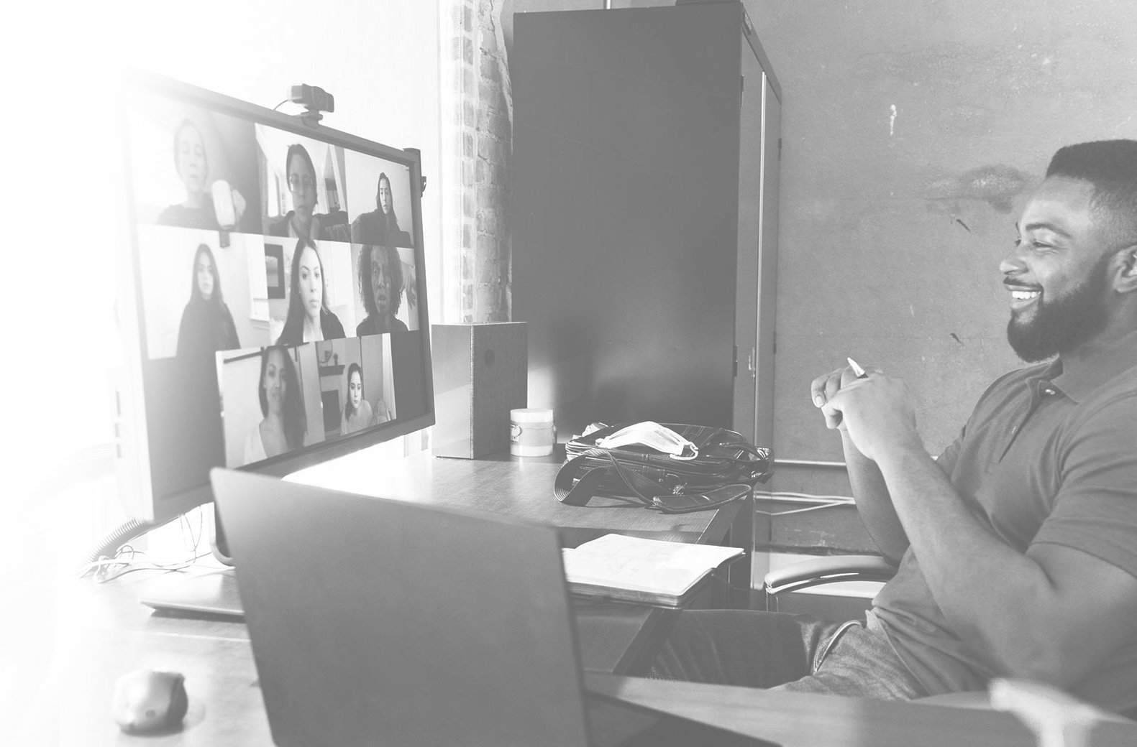
Technology
Providing transparency/remote tools
Moving to paperless processes
Maximizing existing tools
Budgeting for better ones
Leveraging internal systems/apps

Slide 4
Technology

Slide 5
Culture
Onboarding new employees
Work-life balance support
Leaders
Individual contributors
Investing in technology
IT support and accessibility
Ensure productivity whenever, wherever

Slide 6
Work Life Balance
Time zone hurdles
Importance of breaktime
Managing your work hours
Set boundaries for balance
Suggested reading

Slide 7
Work Life Balance

Slide 8
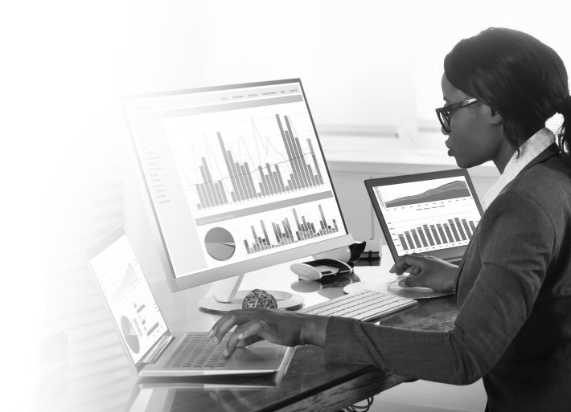
Accountability
Communication/collaboration
Reduce redundancy
Record-keeping
Set deadlines
Be mindful and respectful
Frequent feedback
Mini reviews or 1:1 conversations
KPIs
Measure what matters

Slide 9
Q&A / Open Discussion
How has remote business changed you?
What is better?
What is worse?
What is the future of remote working?

